Slide 1
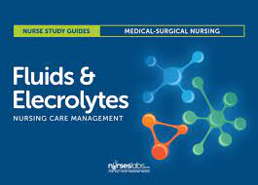
Fundamentals of Nursing(1st Stage)
Fluid and Chemical Balance
Lecture 2
By
Assistant. Lecturer. Zainab Salman Dawood
Fundamentals of Nursing Department
College of Nursing
University of Basrah
University of Basrah –College of Nursing – Fundamentals of Nursing Department

Slide 2
PRINCIPLES OF FLUID, ELECTROLYTES, AND ACID–BASE BALANCE
Fluids and electrolytes are vital to life; adequate balance is imperative to maintain healthy functioning of the body. Fluids and electrolytes are involved in almost every cellular reaction and function. Chemical reactions that occur in the body depend on a careful acid and base balance.
University of Basrah –College of Nursing– Fundamentals of Nursing Department

Slide 3
1- Body Fluids
The primary body fluid is water, making it the most important nutrient of life. Although life can be sustained for many days without food, humans can survive for only a few days without water. The term total body water or fluid refers to the total amount of water, which is approximately 50% to 60% of body weight in a healthy person.
Water in the body functions primarily to:
Transport nutrients to cells and wastes from cells
Transport hormones, enzymes, blood platelets, red and white blood cells
Facilitate cellular metabolism and proper cellular chemical functioning
Act as a solvent for electrolytes and nonelectrolytes
Help maintain normal body temperature
Facilitate digestion and promote elimination
Act as a tissue lubricant
University of Basrah –College of Nursing– Fundamentals of Nursing Department

Slide 4
Body Fluid Compartments
Body fluid is located in two fluid compartments—the intracellular fluid or extracellular fluid, based on its location in the body.
Intracellular fluid (ICF) is the fluid within cells, constituting about 70% of the total body water or 40% of the adult’s body weight.
Extracellular fluid (ECF) is all the fluid outside the cells, accounting for about 30% of the total body water or 20% of the adult’s body weight. ECF includes two major areas, the intravascular and interstitial compartments. A third, usually minor, compartment is the transcellular fluid.
Intravascular fluid, or plasma, is the liquid component of the blood (i.e., fluid found within the vascular system).
Interstitial fluid is the fluid that surrounds tissue cells and includes lymph
Transcellular fluids include cerebrospinal, pericardial, synovial, intraocular, and pleural fluids, as well as sweat and digestive secretions.
University of Basrah –College of Nursing– Fundamentals of Nursing Department

Slide 5
Variations in Fluid Content
Variations in the fluid content from the normal 50% to 60% of the body’s weight can occur, depending on such factors as the person’s age, body fat, and gender.
Infants have considerably more total body fluid and ECF than adults. Because ECF is more easily lost from the body than ICF, infants are more prone to fluid volume deficits. Similarly, the decreasing percentage of body fluid in older people is related to an increase in fat cells.
Total body water also differs by gender and the amount of fat cells in the body. Fat cells contain little water, whereas lean tissue is rich in water. Because women tend to have proportionally more body fat than men do, they also have less body fluid than men.
In addition, older adults lose muscle mass as a part of aging. The combined increase of fat and loss of muscle results in reduced total body water; after the age of 60, total body water is about 45% of a person’s body weight.
University of Basrah –College of Nursing– Fundamentals of Nursing Department

Slide 6
Fluid Balance
1- Fluid Intake
The human body obtains water from several sources, including ingested liquids, food, and as a byproduct of metabolism. The ingestion of liquids provides the largest amount of water normally taken into the body. Fluid intake is regulated primarily by the thirst mechanism. Located within the hypothalamus, the thirst control center is stimulated by intracellular dehydration (the loss of or deprivation of water from the body or tissues) and decreased blood volume.
The water contained in food is the second largest source of water for the body.
Generally, fluid intake averages 2,600 mL per day, with approximately 1,300 mL coming from ingested water, 1,000 mL coming from ingested food, and 300 mL from metabolic oxidation.
University of Basrah –College of Nursing– Fundamentals of Nursing Department

Slide 7
.
2- Fluid Loss
Fluid is lost from the body through sensible and insensible losses. Sensible losses can be measured and include fluid lost during urination, defecation, and wounds. Insensible losses cannot be measured or seen and include fluid lost from evaporation through the skin and as water vapor from the lungs during respiration.
Fluid output averages 2,500 to 2,900 mL per day with approximately 1,500 mL as urine from the kidneys, 600 mL fluid loss from the skin, 300 mL from the lungs, and 200 mL in feces via the gastrointestinal tract .
University of Basrah –College of Nursing– Fundamentals of Nursing Department

Slide 8
Fluid Imbalances
1- Fluid Volume Deficit(FVD)
is caused by a loss of both water and solutes in the same proportion from the ECF space. This state is commonly known as hypovolemia or isotonic fluid loss.
Fluid volume deficits result from the loss of body fluids, especially if fluid intake is decreased simultaneously. Young children, older adults, and people who are ill are especially at risk for hypovolemia. Fluid volume deficit can rapidly result in a weight loss of 5% in adults and 10% in infants.
A 5% weight loss is considered a pronounced fluid deficit; an 8% loss or more is considered severe. A 15% weight loss caused by fluid deficiency usually is life threatening.
University of Basrah –College of Nursing– Fundamentals of Nursing Department

Slide 9
2- Fluid Volume Excess (FVE)
retention of water and sodium in ECF in near equal proportions results in a condition termed fluid volume excess. It is also called hypervolemia or excess of isotonic fluid.
Common causes include malfunction of the kidneys, causing an inability to excrete the excesses, and failure of the heart to function as a pump, resulting in accumulation of fluid in the lungs and dependent parts of the body.
Accumulation of fluid may result in a weight gain in excess of 5%. Although the body attempts to maintain normal balance in all fluid spaces, the intravascular fluid is usually protected at the expense of interstitial fluid and ICF.
University of Basrah –College of Nursing– Fundamentals of Nursing Department

Slide 10
2- Electrolytes
Electrolytes are substances that are capable of breaking into particles called ions. An ion is an atom or molecule carrying an electrical charge. Some ions develop a positive charge and are called cations. The major cations in body fluid are sodium, potassium, calcium, hydrogen, and magnesium ions. Other ions develop a negative charge and are called anions. The major anions in body fluid are chloride, bicarbonate, and phosphate. These charged particles are the basis of chemical interactions in the body necessary for metabolism and other functions. Molecules in the body that remain intact, without a charge, are called nonelectrolytes. In the human body, urea and glucose are examples of nonelectrolytes.
University of Basrah –College of Nursing– Fundamentals of Nursing Department

Slide 11
Regulation and Homeostatic Mechanisms of Fluid and Electrolyte Balance
Fluid and electrolyte balance is maintained by a number of mechanisms to facilitate fluid and electrolyte movement within the body. Solvents are liquids that hold a substance in solution; solutes are substances that are dissolved in a solution. Water is the primary solvent in the body. The solutes are electrolytes and nonelectrolytes. The body produces balance by shifting fluids and solutes between the ECF and the ICF. The mechanisms responsible for regulating this shift of fluids and transporting materials to and from intracellular compartments include: organs and body systems, osmosis, diffusion, active transport, and capillary filtration.
University of Basrah –College of Nursing– Fundamentals of Nursing Department

Slide 12
1- Organs and Body Systems
Almost every organ and system in the body helps in some way to maintain fluid homeostasis. Osmosis Cell membranes are semipermeable, allowing some, but not all, solutes to pass through the cell membranes. The cell membrane is permeable to water or fluids.
2- Osmosis
is the major method of transporting body fluids. Water shifts and balance depend heavily on this route of transport . Through the process of osmosis, water (the solvent) passes from an area of lesser solute concentration and more water to an area of greater solute concentration and less water untile quilibrium is established.
University of Basrah –College of Nursing– Fundamentals of Nursing Department

Slide 13
3-Diffusion
Diffusion is the tendency of solutes to move freely throughout a solvent. The solute moves from an area of higher concentration to an area of lower concentration (i.e., “downhill”) until equilibrium is established. Gases also move by diffusion. Oxygen and carbon dioxide exchange in the lung’s alveoli and capillaries occurs by diffusion.
4- Active Transport
Active transport is a process that requires energy for the movement of substances through a cell membrane, against the concentration gradient, from an area of lesser solute concentration to an area of higher solute concentration.
5- Capillary Filtration
Filtration is the passage of fluid through a permeable membrane. Fluids move from an area of high pressure to one of lower pressure. Capillary filtration results from the force of blood “pushing” against the walls of the capillaries.
University of Basrah –College of Nursing– Fundamentals of Nursing Department

Slide 14
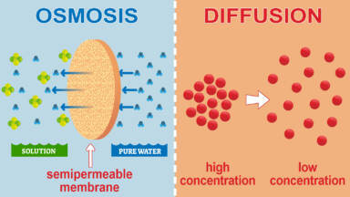
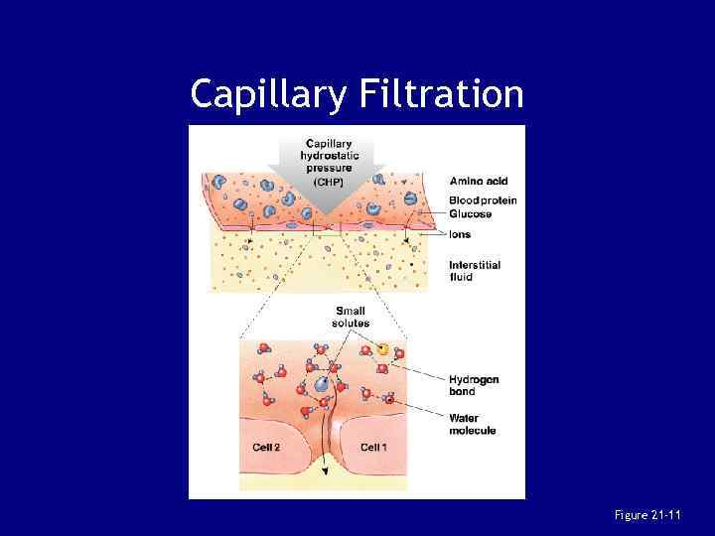
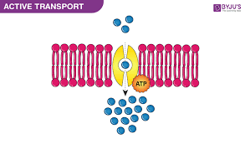
University of Basrah –College of Nursing– Fundamentals of Nursing Department

Slide 15
Electrolyte Imbalances
1- Hyponatremia and Hypernatremia
Hyponatremia refers to a sodium deficit in ECF (serum sodium <135 mEq/L) caused by a loss of sodium or a gain of water. Sodium may be lost through vomiting, diarrhea, fistulas, sweating, or as the result of the use of diuretics. The decrease in sodium causes fluid to move by osmosis from the less concentrated ECF compartment to the ICF space. This shift of fluid leads to swelling of the cells, with resulting confusion, hypotension, edema, muscle cramps and weakness, and dry skin. Cerebral edema can lead to seizures. Permanent neurologic damage and death can result from severe hyponatremia.
Hypernatremia refers to a surplus of sodium in ECF (serum sodium >145 mEq/L) caused by excess water loss or an overall excess of sodium. Fluid deprivation, lack of fluid consumption (such as in patients who cannot perceive, respond to, or communicate thirst ,diarrhea, and excess insensible water loss (hyperventilation, burns) lead to excess sodium. The cells of the central nervous system are especially affected, resulting in signs of neurologic impairment, including restlessness, weakness, disorientation, delusion, and hallucinations. Permanent brain damage, especially in children, can occur
University of Basrah –College of Nursing– Fundamentals of Nursing Department

Slide 16
2- Hypokalemia and Hyperkalemia
Hypokalemia refers to a potassium deficit in ECF (serum potassium <3.5 mEq/L) and is a common electrolyte abnormality. Potassium may be lost through vomiting, gastric suction, alkalosis, diarrhea, or as the result of
the use of diuretics. Typical signs of hypokalemia include muscle weakness and leg cramps, fatigue, paresthesias, and dysrhythmias.
Hyperkalemia refers to an excess of potassium in ECF (serum potassium >5 mEq/L). Excess potassium may result from renal failure, or the use of certain medications. Although this condition occurs less frequently than hypokalemia, it can be much more dangerous. Nerve conduction as well as muscle contractility can be affected. Skeletal muscle weakness and paralysis may occur. A variety of cardiac irregularities may result, including cardiac arrest if hyperkalemia is not corrected.
University of Basrah –College of Nursing– Fundamentals of Nursing Department

Slide 17
3- Hypocalcemia and Hypercalcemia
Hypocalcemia refers to a calcium deficit in ECF (serum calcium <8.9 mg/dL, ionized calcium <4.5 mg/dL). Common causes related to a calcium deficit involve inadequate calcium intake, impaired calcium absorption, and excessive calcium loss. Manifestations of hypocalcemia include numbness and tingling of fingers, mouth, or feet; tetany; muscle cramps; and seizures.
Hypercalcemia refers to an excess of calcium in ECF (serum calcium >10.1 mg/dL, ionized calcium >5.1 mg/dL). Two major causes of hypercalcemia are cancer and hyperparathyroidism. Manifestations of hypercalcemia include nausea, vomiting, constipation, bone pain, excessive urination, thirst, confusion, lethargy, and slurred speech. Severe hypercalcemia (serum calcium ≥17 mg/dL) is an emergency situation because cardiac arrest may result.
University of Basrah –College of Nursing– Fundamentals of Nursing Department

Slide 18
3- Acid–Base Balance
Body fluids must maintain an acid–base balance to sustain health and life. Specific chemical reactions are constantly occurring within the body that influence metabolism and the functions of various bodily systems. These chemical reactions are dependent on a balance of acids and bases.
Acidity or alkalinity of a solution is determined by its concentration of hydrogen ions (H+).
An acid is a substance containing H+ that can be liberated or released, such as carbonic acid.
An alkali, or base, is a substance that can accept or trap H+ ions, such as the bicarbonate ion.
University of Basrah –College of Nursing– Fundamentals of Nursing Department

Slide 19
The unit of measure used to describe acid–base balance is pH, which is an expression of H+ ion concentration and the resulting acidity or alkalinity of a substance.
The pH scale ranges from 1 to 14.
A neutral solution measures 7; an example is pure water.
As the H+ ions increase and a solution becomes more acid, the pH becomes less than 7.
When the concentration of H+ ions in a solution is reduced or accepted by another substance and the solution contains more base than acid, it is alkaline, and the pH is greater than 7.
University of Basrah –College of Nursing– Fundamentals of Nursing Department

Slide 20
Respiratory Acidosis and Alkalosis
Respiratory acidosis is a primary excess of carbonic acid in the ECF. It is produced by inadequate excretion of CO2 with inadequate ventilation, resulting in elevated plasma CO2 and increased levels of carbonic acid. Any decrease in alveolar ventilation that results in retention of carbon dioxide can cause respiratory acidosis.
Respiratory alkalosis is a primary deficit of carbonic acid in the ECF. It is the result of alveolar hyperventilation, breathing that is faster and deeper, and the consequent increase in the elimination of CO2. This loss of CO2 leads to a decrease in the carbonic acid level in the plasma and an increase in the pH.
University of Basrah –College of Nursing– Fundamentals of Nursing Department

Slide 21
Thanks
University of Basrah –College of Nursing– Fundamentals of Nursing Department

